Slide 1
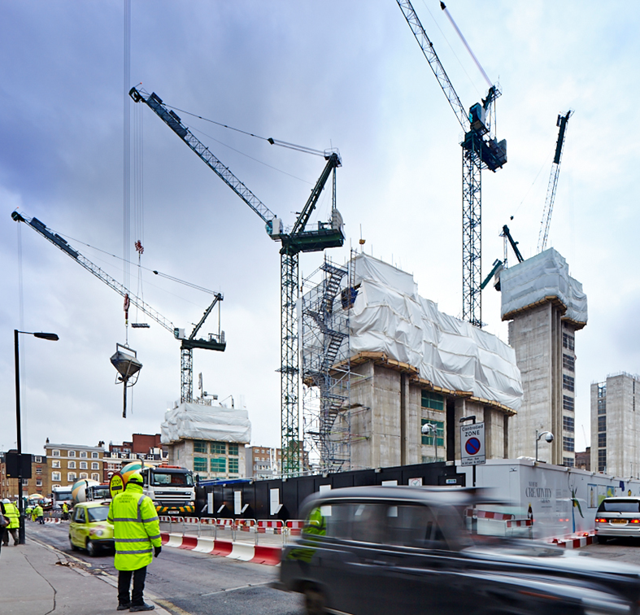

Master Class: Introduction to Machine Learning

Slide 2
Let’s get setup.
If you want to code with me – EVERYTHING you need is in my slide deck, so download it from here:
https://tinyurl.com/y2q3phvg

Slide 3

Let’s get setup.
Sign in
(or create one - but who doesn’t have a Google account right?!)

Slide 4
Overview
Let’s get setup
Who am I?
Which Integrated Dev Environment (IDE)?
How to make progress on your own!
Why Python?
What is machine learning?
Machine learning examples

Slide 5

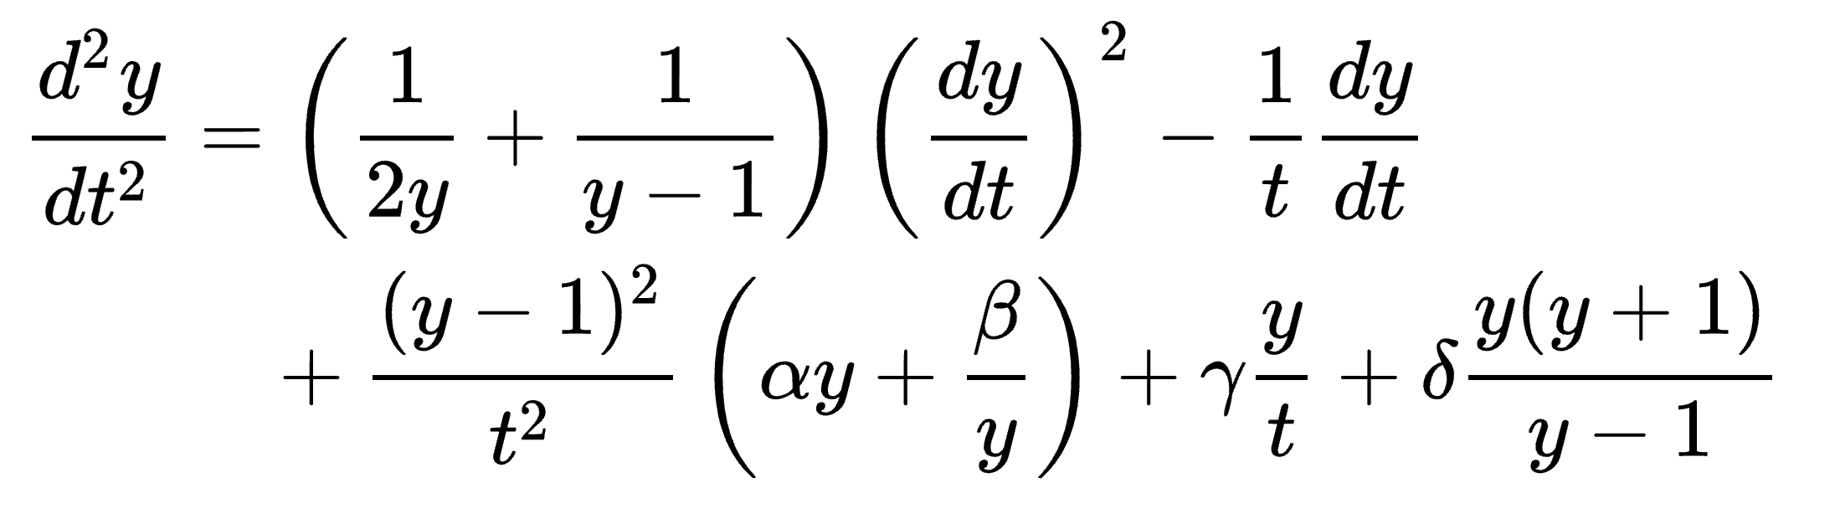


Who am I?
Completed my PhD in applied Mathematics in 2015 – Painlevé equations and Orthogonal Polynomials
Lectured mathematics at the University of Kent
Joined Projecting Success in 2017
Mathematics
Interests:
Machine Learning
Python
Notes:
I am a

Slide 6
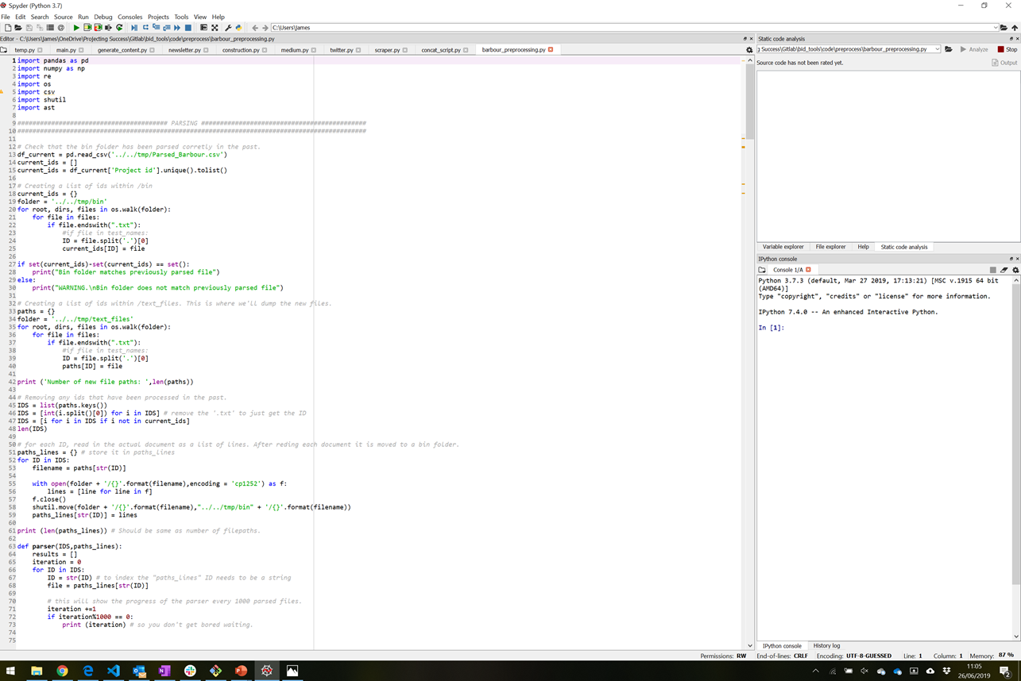
Which Integrated Dev Environment (IDE)?

Slide 7
Which Integrated Dev Environment (IDE)?
Save and reload code files If an IDE or editor won’t let you save your work and reopen everything later, in the same state it was in when you left, it’s not much of an IDE.
Run code from within the environment Similarly, if you have to drop out of the editor to run your Python code, then it’s not much more than a simple text editor.
Debugging support Being able to step through your code as it runs is a core feature of all IDEs and most good code editors.
Syntax highlighting Being able to quickly spot keywords, variables, and symbols in your code makes reading and understanding code much easier.
Automatic code formatting
Any editor or IDE worth it’s salt will recognize the colon at the end of a while or for statement and know the next line should be indented.

Slide 8


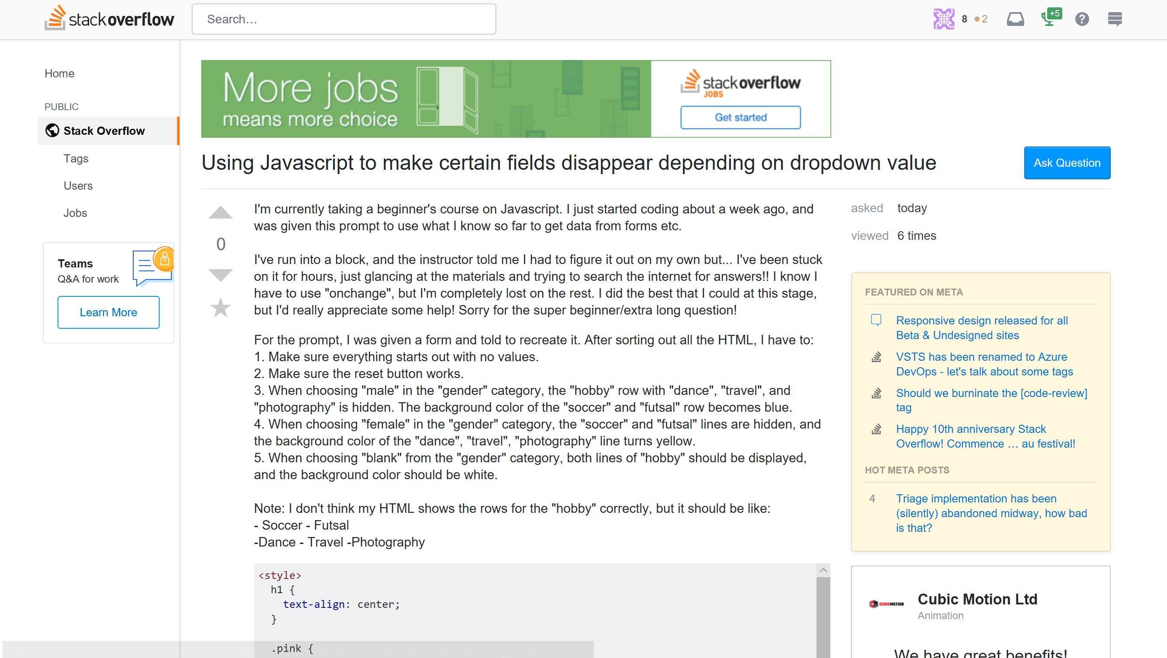
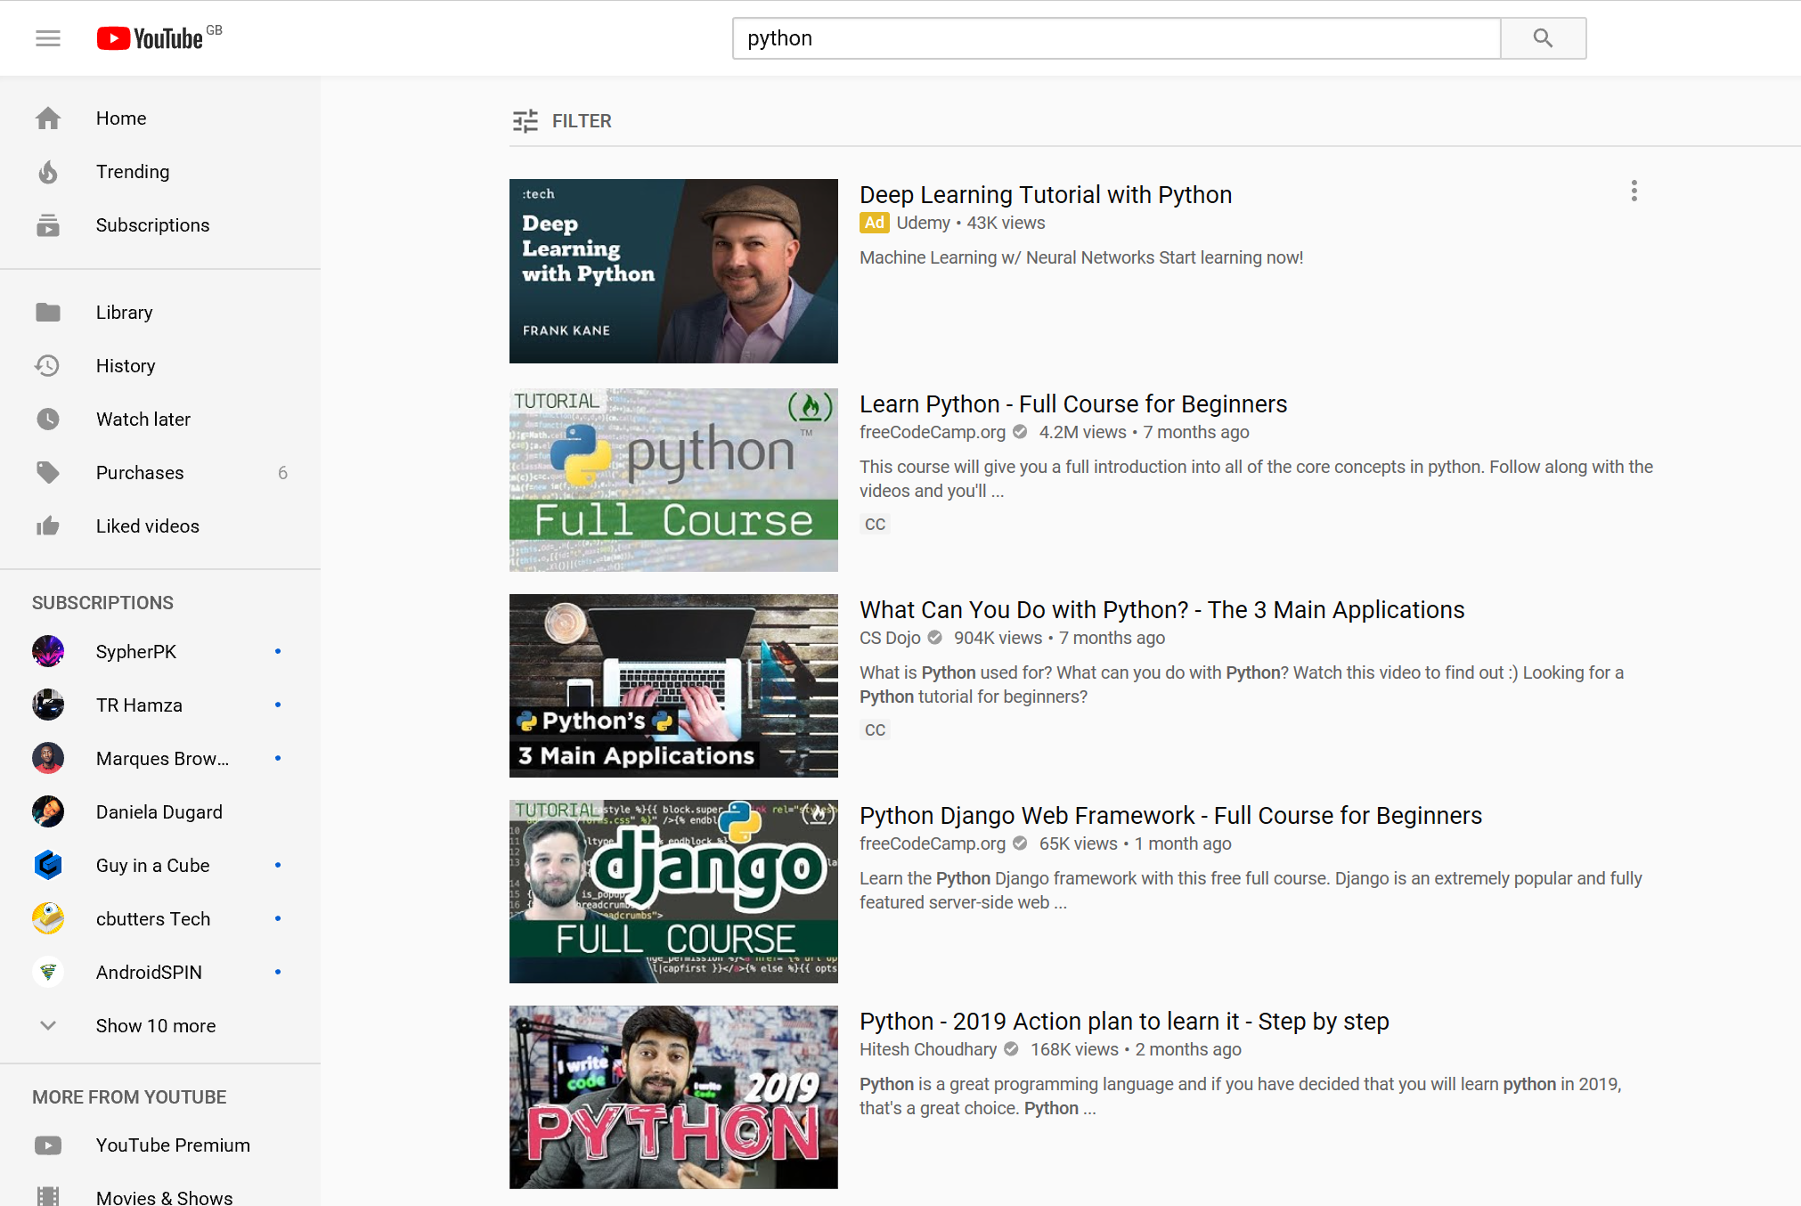
How to make progress on your own!
https://github.com
https://www.udemy.com
https://stackoverflow.com/
https://www.youtube.com/

Slide 9
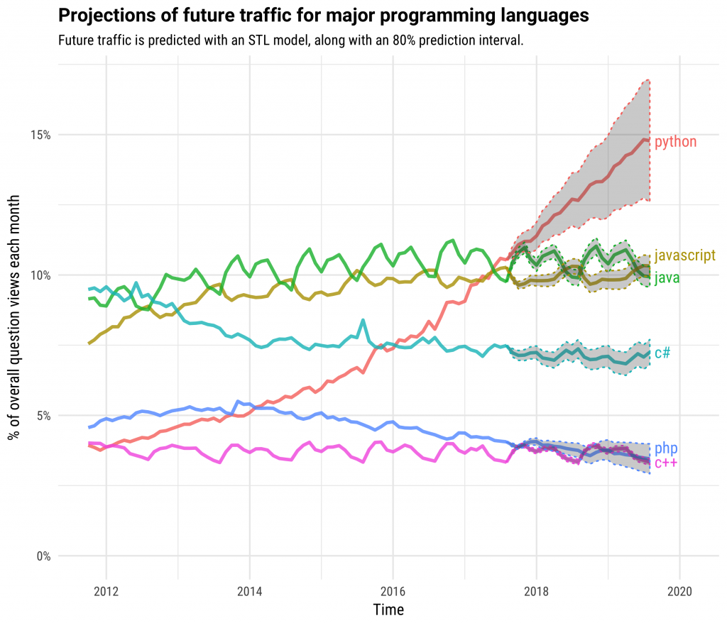
Why Python?

Slide 10

What is Machine Learning?
Machine learning is a type of artificial intelligence that enables self learning from data.
Algorithms using statistics are used to understand and predict data patterns.
In projects it could be used to predict how long a project should take or possible dangers in a project.

Slide 11
Types of Machine Learning
Supervised | Unsupervised
Generally the most basic form of machine learning. Labelled data (data with a tag i.e. name) is used to train the model. | Unsupervised learning is a type of machine learning that looks for previously undetected patterns in a data set with no labels and with a minimum of human supervision.
Relationships in the data are uncovered using the labels assign to the data. | These algorithm generally use larger data sets.
Generally smaller data set.

Slide 12
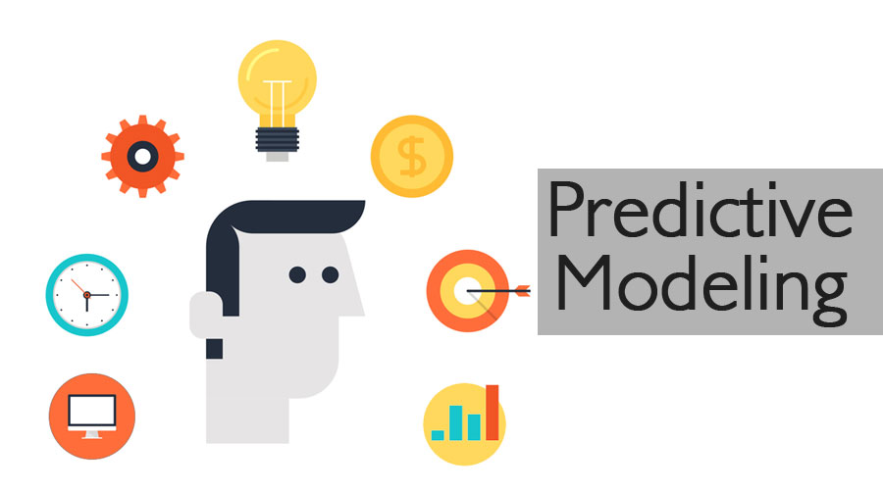


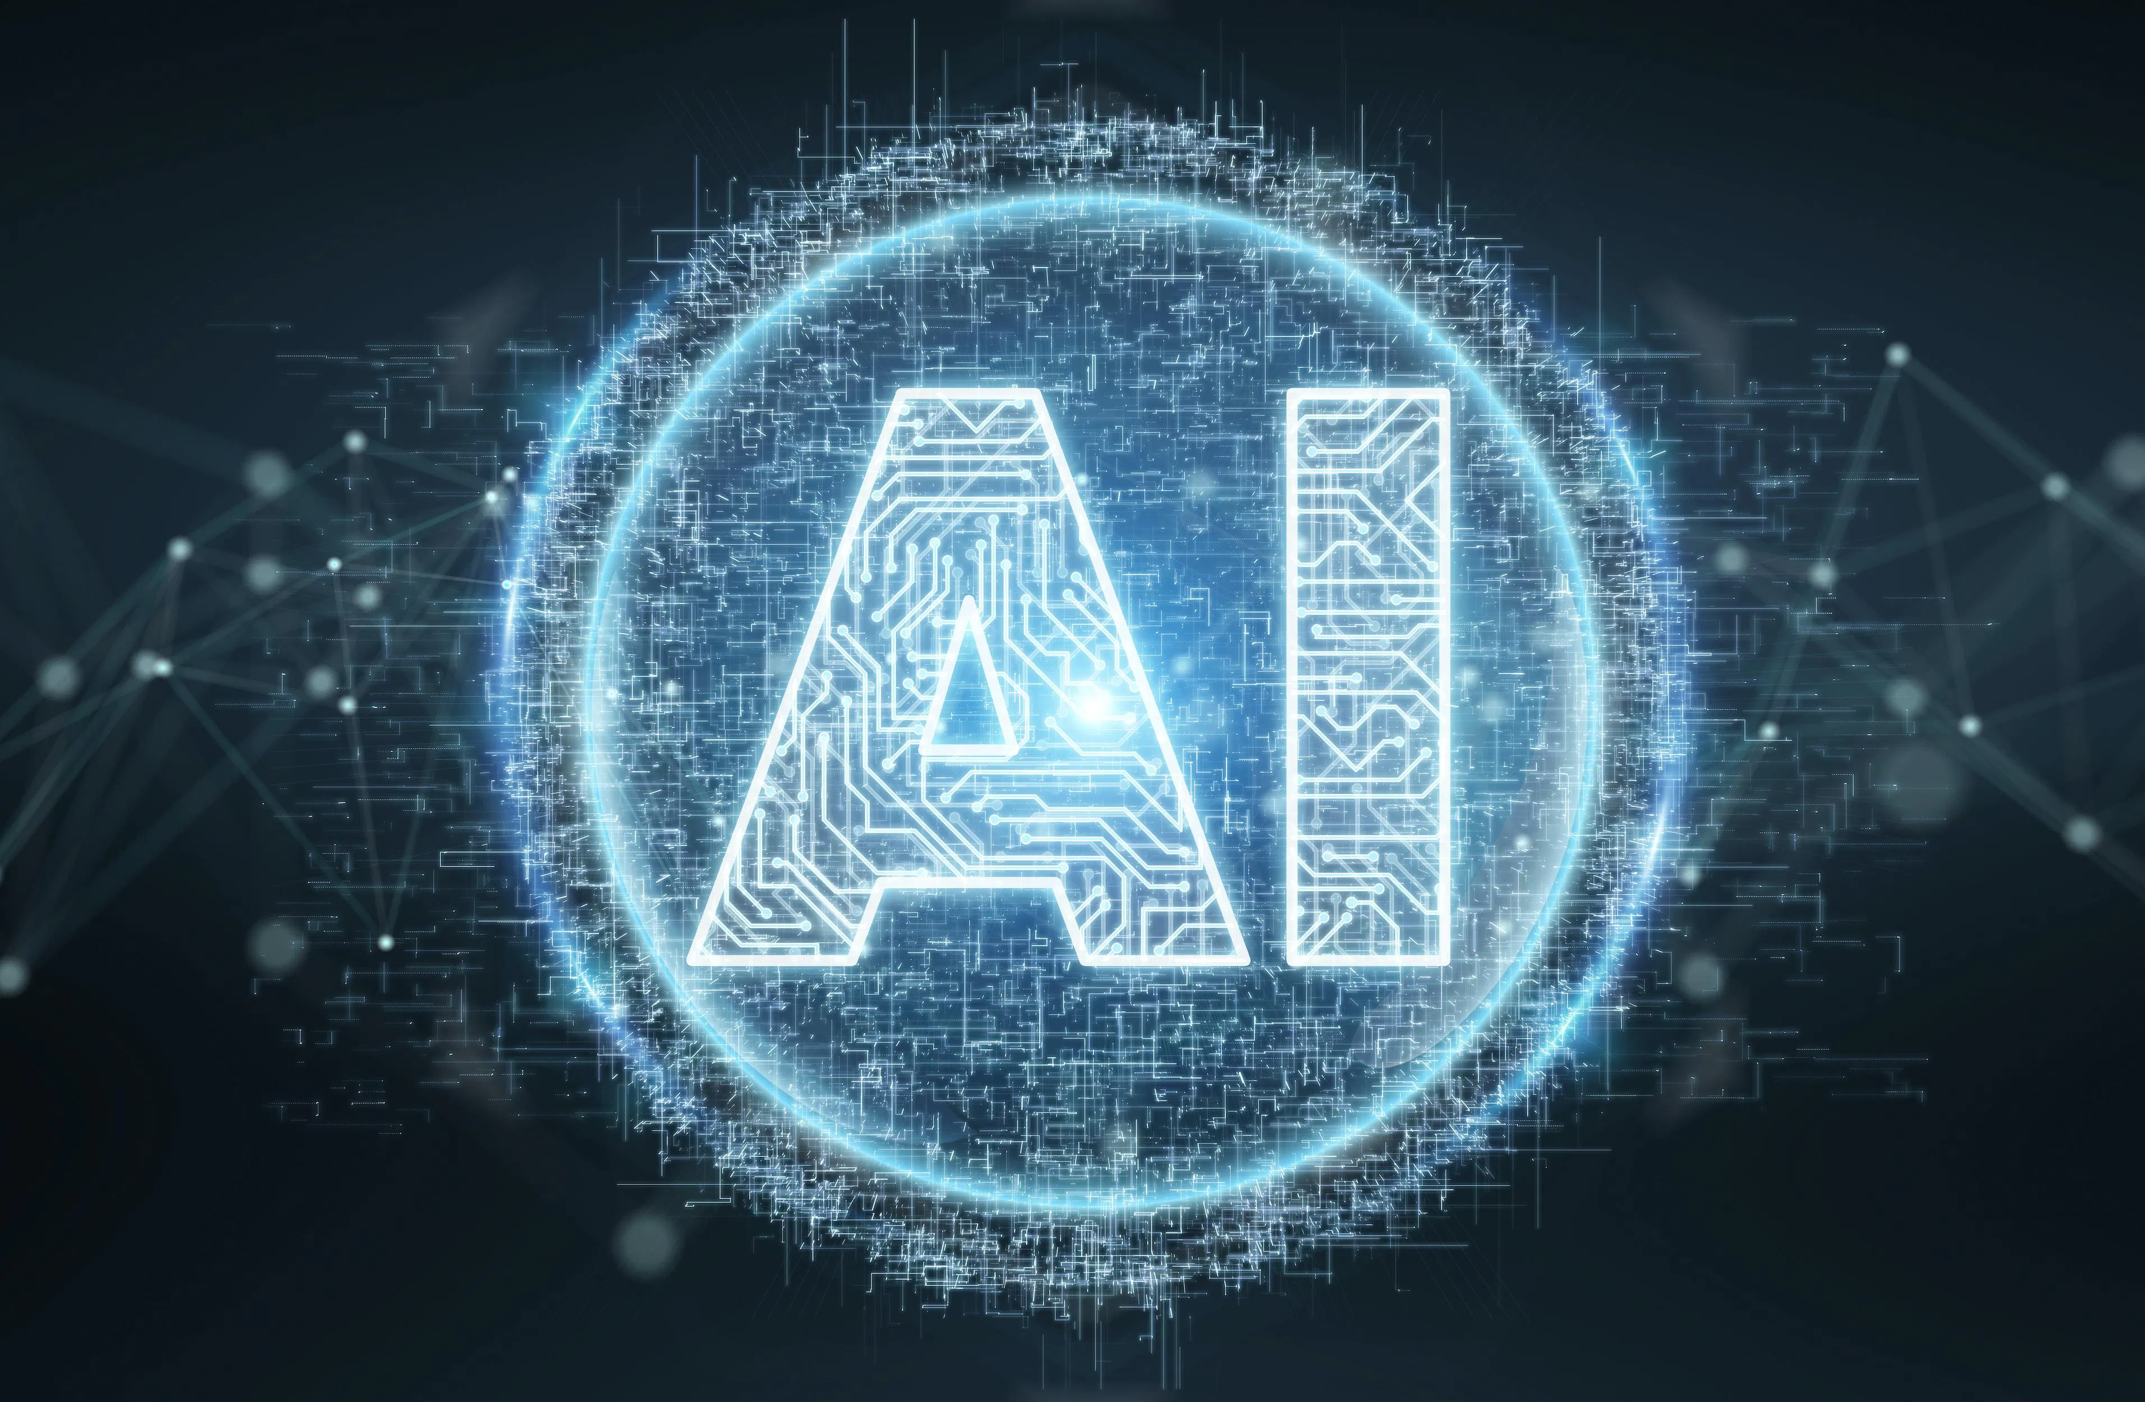
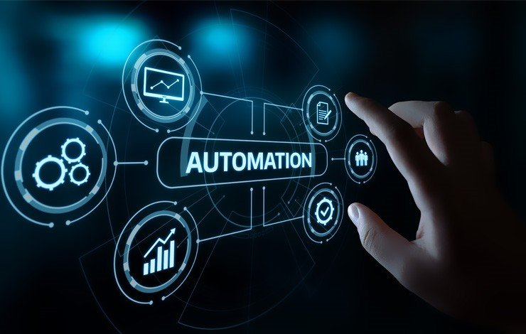

Application of Machine Learning and AI

Slide 13

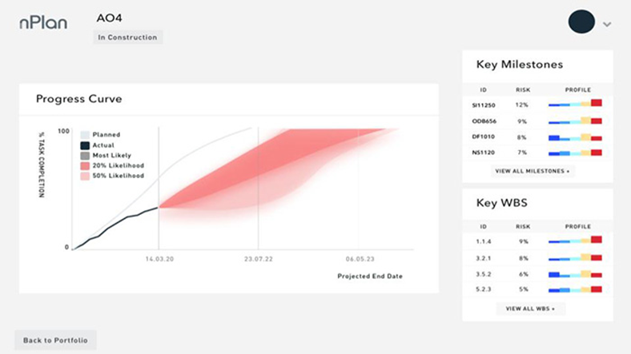
Application of Machine Learning and AI – nPlan
nPlan has been using machine learning to learn from past mistakes.
They collected vast amount of historical data.
With this they can figure out what is causing delays in project, via the use of machine learning.
They can also predict how long a project will actually take.

Slide 14
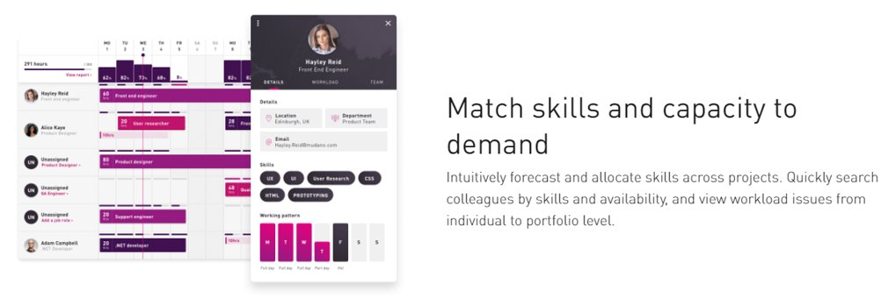

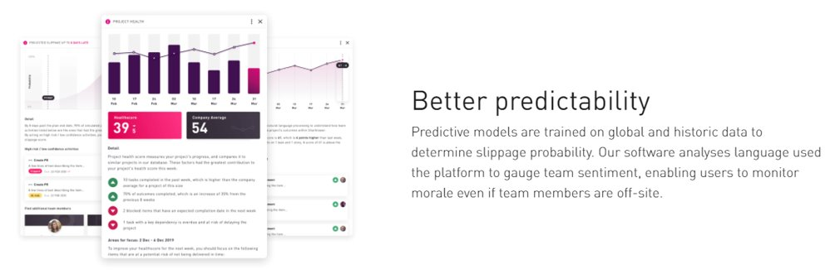
Application of Machine Learning and AI – SharkTower

Slide 15

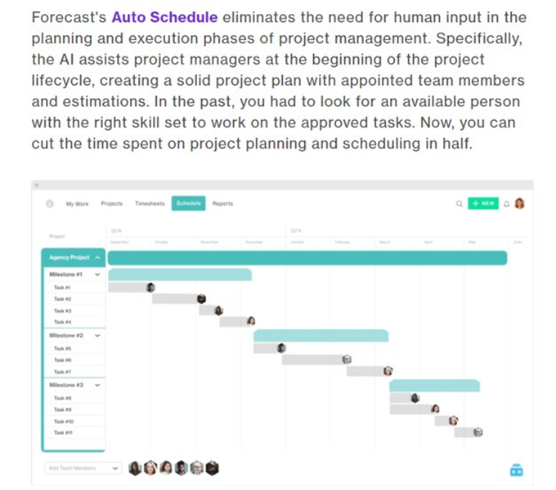
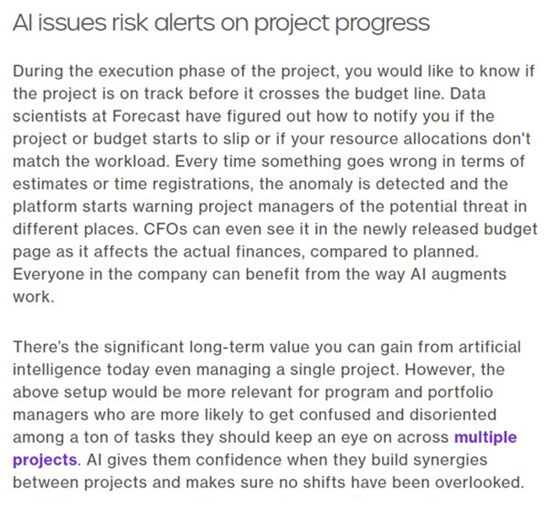
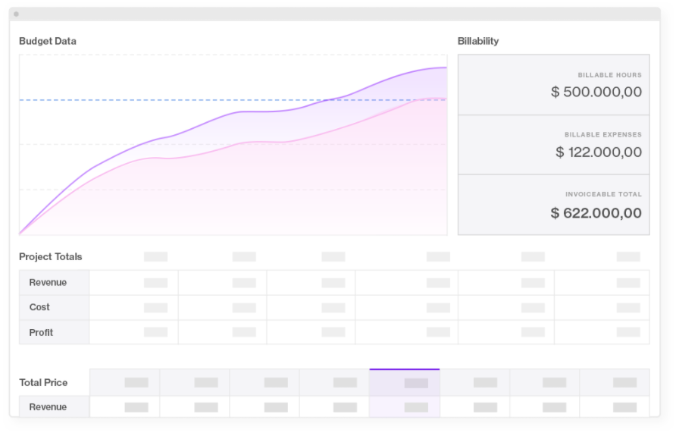
Application of Machine Learning and AI – Forecast

Slide 16
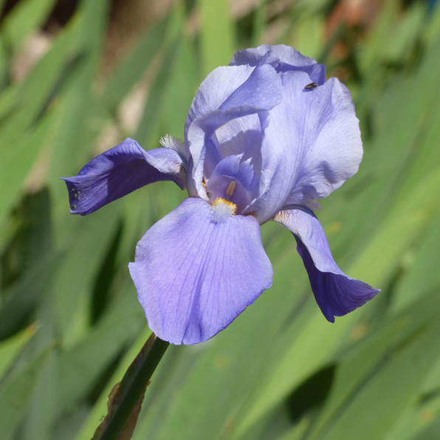

Machine Learning Example - Iris
To get a better understanding of Machine learning we’ll have a quick look at the Iris data set being used to train a logistic regression model
GitHub
https://colab.research.google.com/

Slide 17
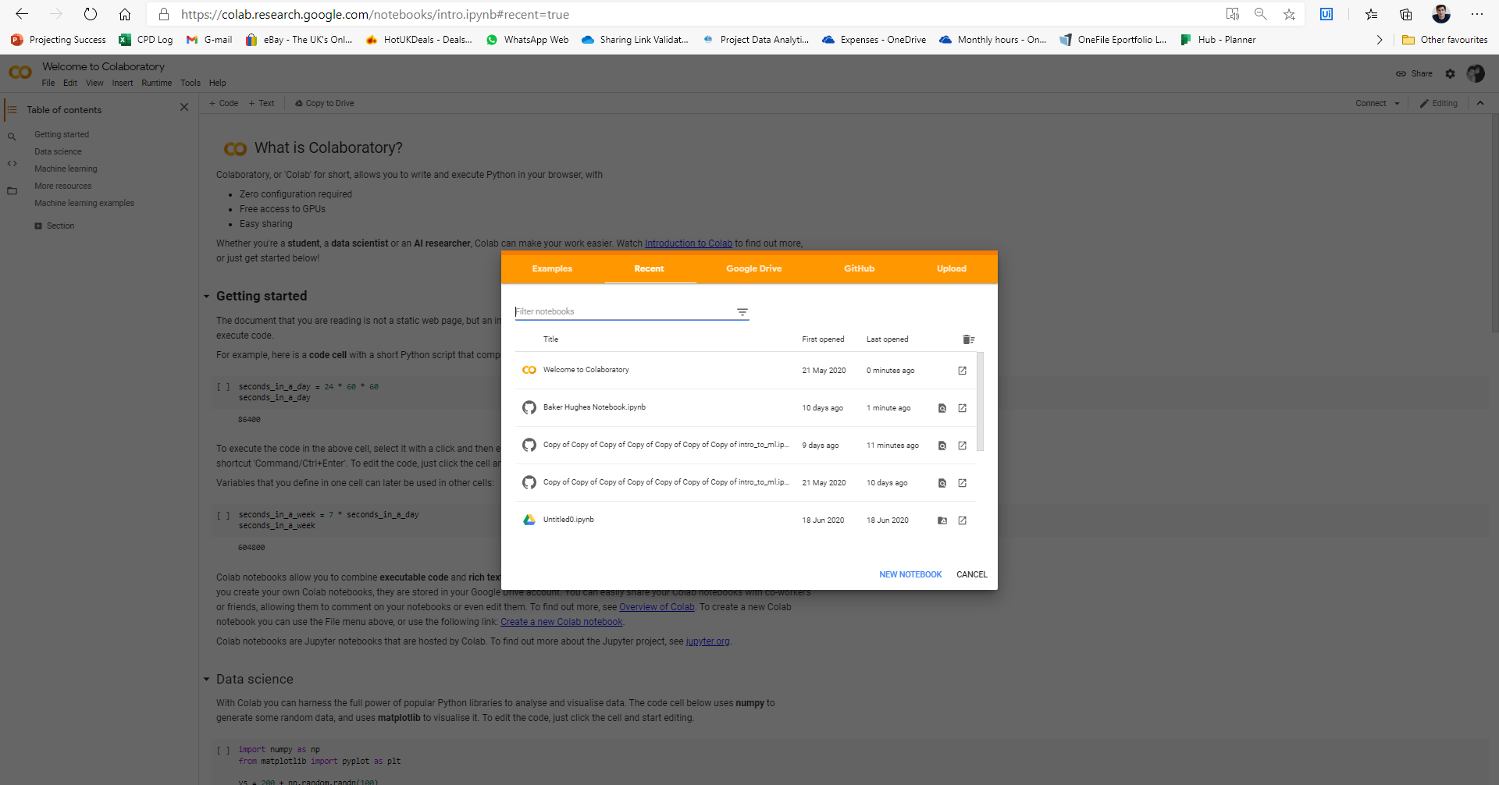
Machine Learning Example - Iris

Slide 18
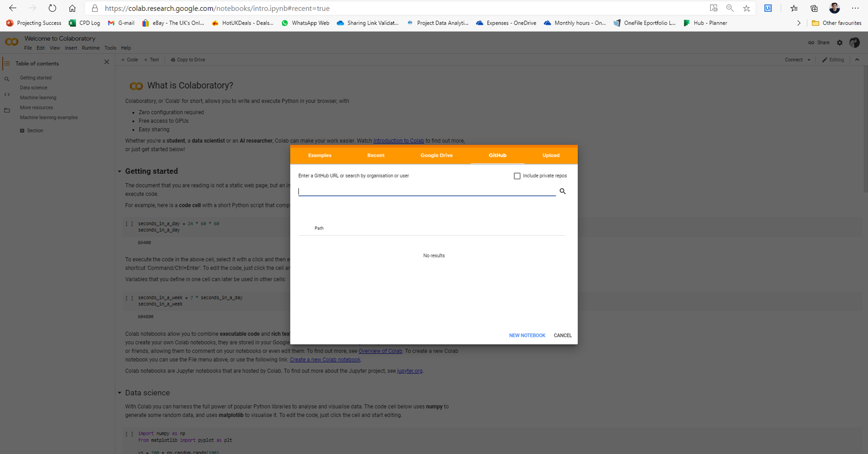
Machine Learning Example - Iris
https://github.com/James-G-Smith/Python-projects/blob/master/Introduction to machine learning/code/intro_to_ml.ipynb

Slide 19

Background
At Hack 6 Baker Hughes provide a large amount of schedule data coming from their Primavera P6 software. They wanted to understand what caused variation in timings for activities in their data.
All data derives from the SPS(Subsea Production Systems) projects.
Activity Durations are baselined, but there is variance vs Actual Durations that we would like to assess and potentially to minimise.
This data came from 111 schedules.
Almost 100,000 activities.
It included data on complete and incomplete activities.
Data on department type, activity type, planned duration, forecast duration and other scheduling data was provided.
We will explore how to solve this solution using Python.

Slide 20
Stages of the Solution
Identify problem using business knowledge
Collect Data – From Primavera P6
Clean the data
Explore the Data
Data Preparation – Feature Creation
Modelling
Model Evaluation
Deployment

Slide 21

1.Problem Statement
As a business, we would like you to help us understand our Activity Duration Variance. Can we apply machine learning to our schedule data to understand the features or conditions that are the biggest causes of duration variance in projects?

Slide 22
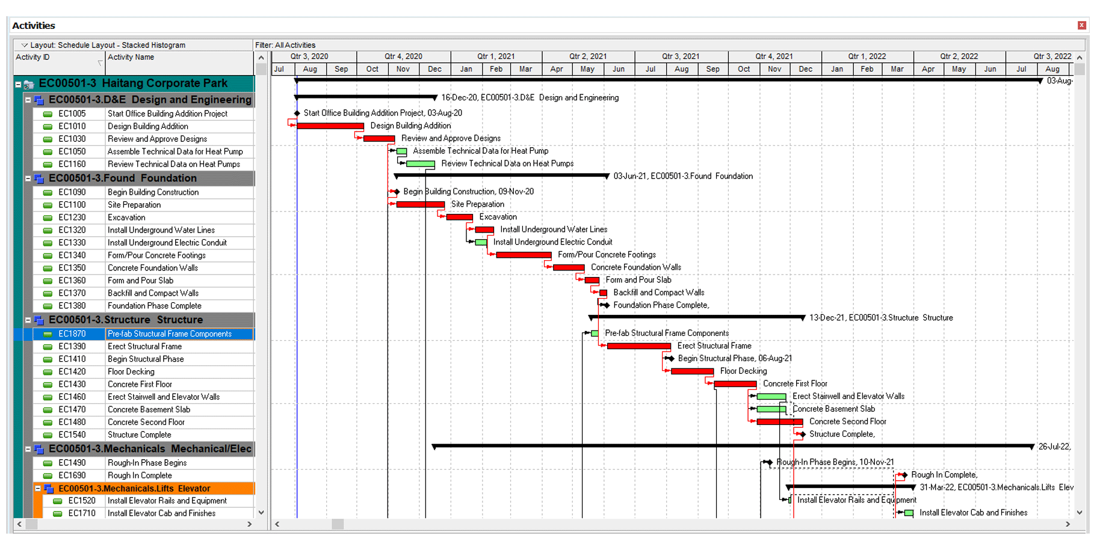
2.Data Collection
Data is needed for our analysis and model.
In this case data is collected from the Primavera P6 scheduling software.
The data is extracted from the software as a csv(comma separated values) file.

Slide 23


3.Clean Data

Slide 24
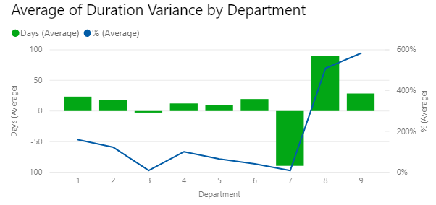
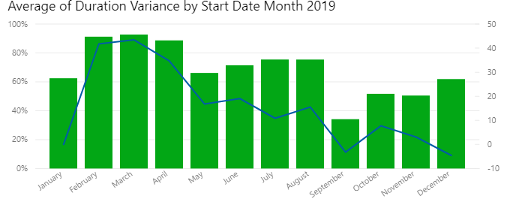
4. Explore the Data
The scheduling data needed to be explored to understand underlying patterns and trends within the data.
Important this does not give a full analysis. It only gives a broad over view of the data.
In doing this, it is easier to home into interesting aspects of the data.
This is exploration was carried out in the hack in Power BI.

Slide 25

5. Data Preparation 6. Modelling 7. Model Evaluation
This is carried out and explained in the tutorial.

Slide 26

8. Deployment
Deployment is the process of integrating the machine learning model into a company’s day to day systems it needs to be deployed.
In this example a deployed model would re-train and create a new prediction anytime new data is created in the scheduling software.
This would work in the background and be seamless.
To achieve this platforms such as Azure Machine Learning, AWS(Amazon Web Services) and others can be used.

Slide 27

Machine Learning Industry Example - Baker Hughes
GitHub
https://colab.research.google.com/

Slide 28



Please find me on Linkedin
Dr James Smith
CTO
www.projectingsuccess.co.uk
Jamessmith@projectingsuccess.co.uk
+44 7891805279

